Slide 1

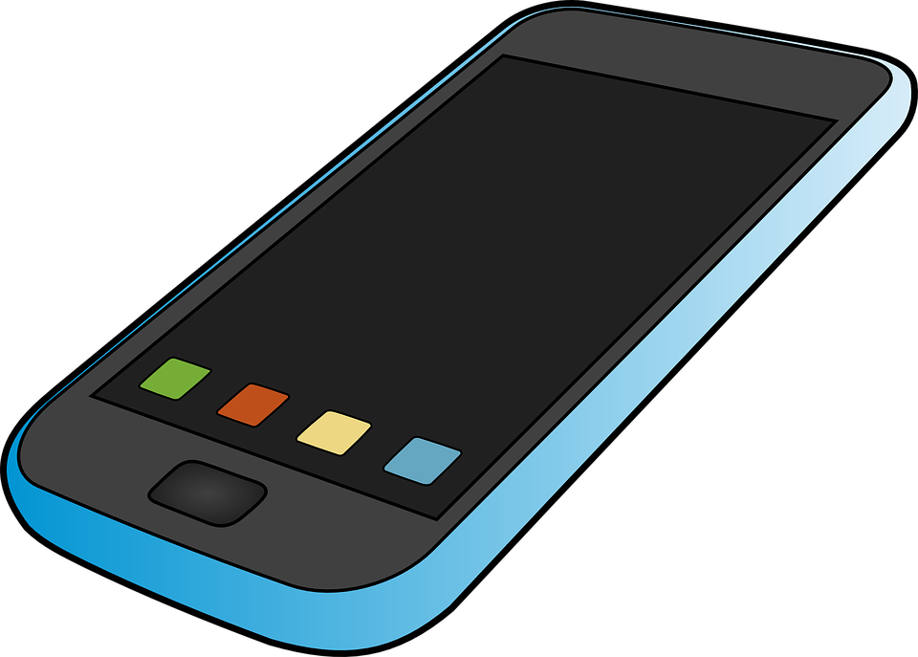

Slide 2
How many of us are have old unused mobile devices getting dust in the drawer?
Now it is time to use them again.
With Rufi app you can take advantage of your old device’s sensors and use it as a security alarm for your house, your motorbike, your car, even as a baby sleep monitoring device!

Slide 3
You just select the mode that you prefer, import your active mobile phone number and let Rufi track the environment and inform you when a change happens. The different modes are shock, magneto, microphone and much more.

Slide 4
On shock mode, when your device moves -for example if you put it under the seat of your motorbike- you can identify when someone tries to move your motorbike.
On magneto mode, when your device changes direction -for example if you put it behind your house’s entrance door when going for vacation- you can identify when someone tries to break in your house.
On microphone mode, when your device hears a sound, -for example if you place it close to your sleeping baby-, you will get informed when your baby wakes up.

Slide 5
Give life to your old devices again, and get informed about changes of the environment!

